Slide 1
CARBON FOOTPRINT CALCULATOR (SKILLX PROJECT )
DEPARTMENT : B.TECH CSE
YEAR : 3rd
SEMESTER : 5th

Slide 2
GROUP MEMBERS :
. SHREYA DAS (22CS011184)
. SWIKRITI SUMAN(22CS011232)
. TRISHA KUNDU(22CS011235)
. TWISHA BARIK(22CS011237)
. SIDDIQUAN JAWAID(22CS011190)

Slide 3

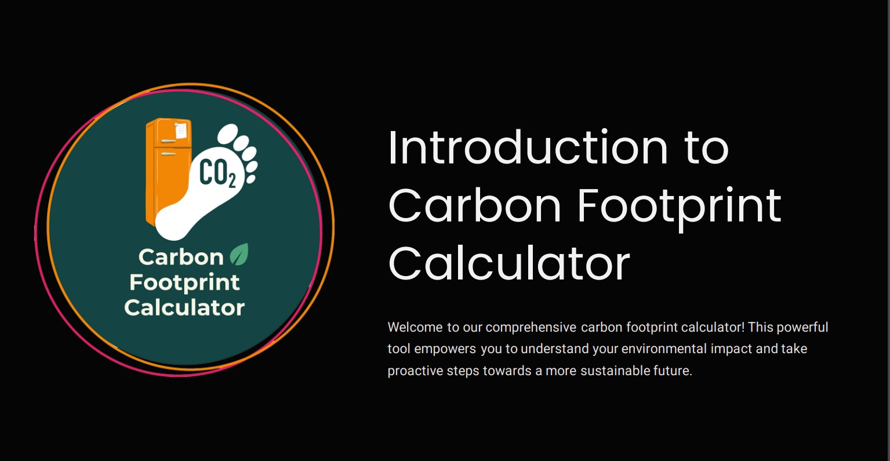

Slide 4
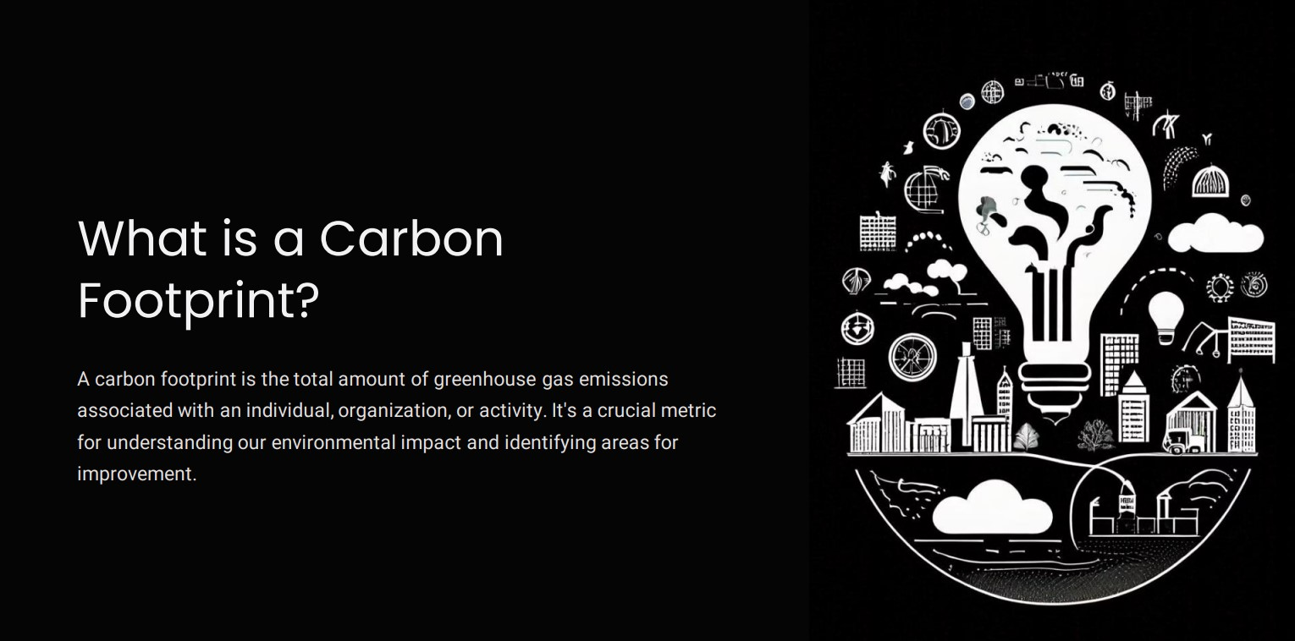

Slide 5
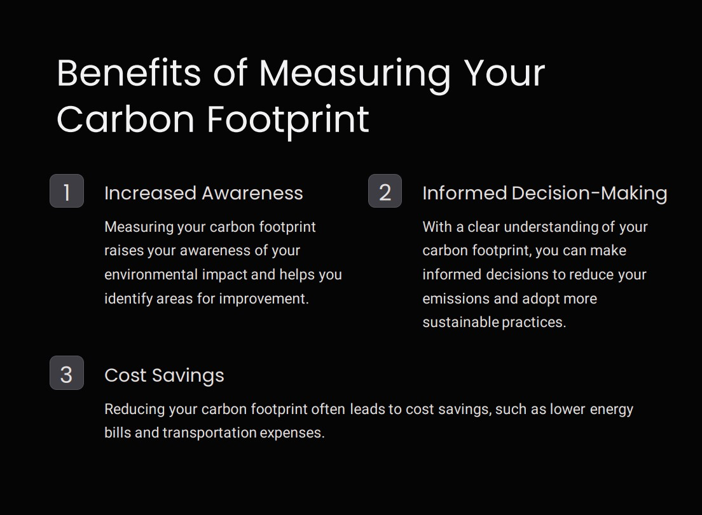

Slide 6
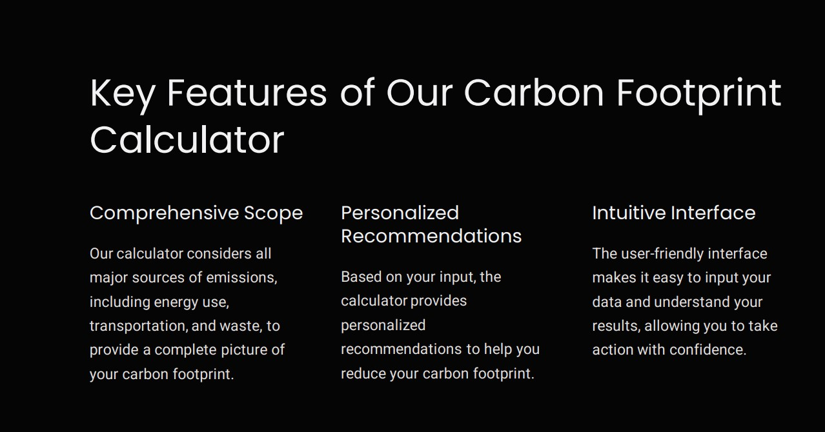

Slide 7
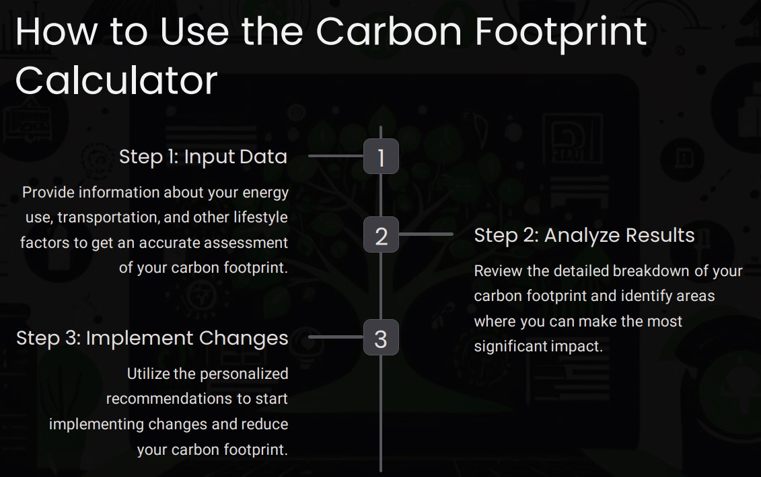

Slide 8
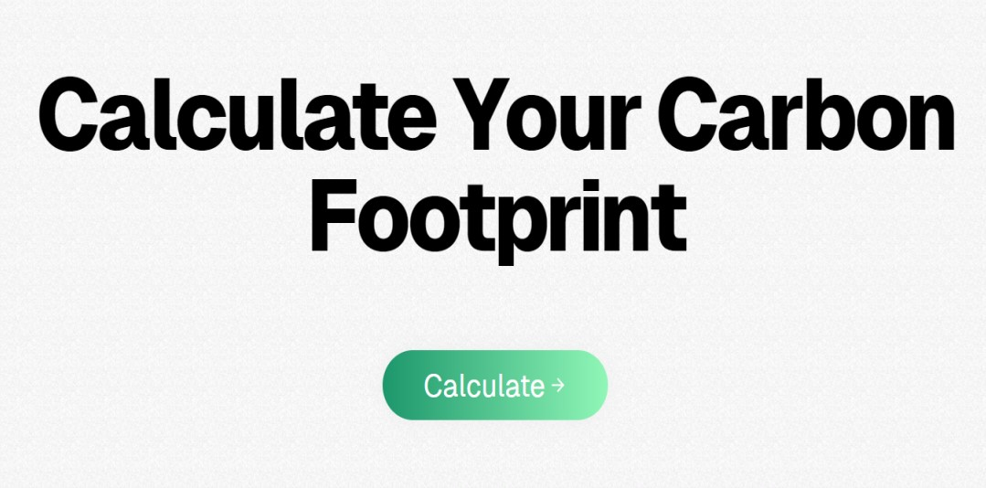

Slide 9
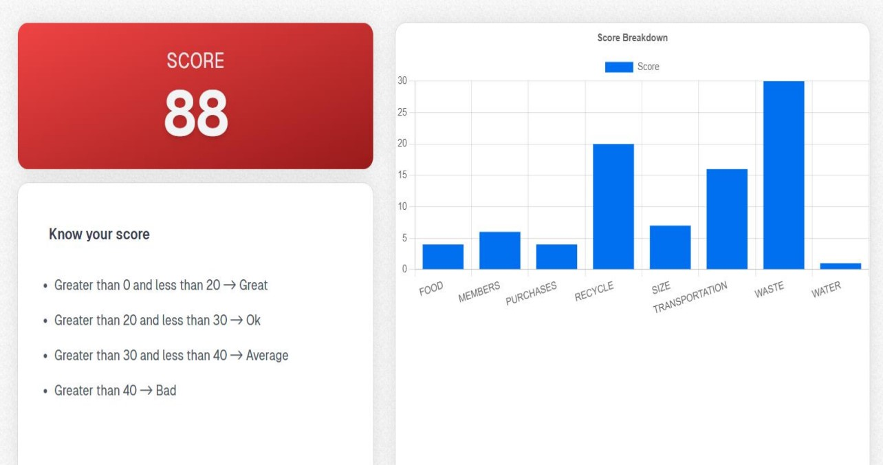

Slide 10
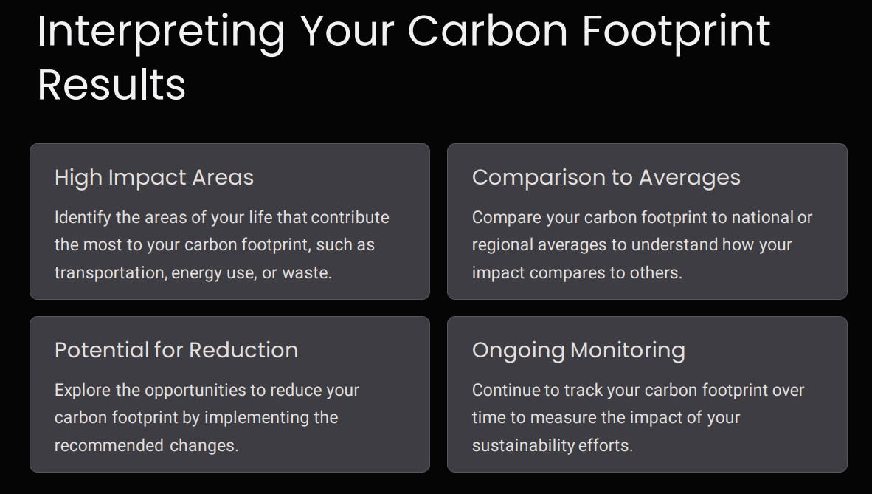

Slide 11
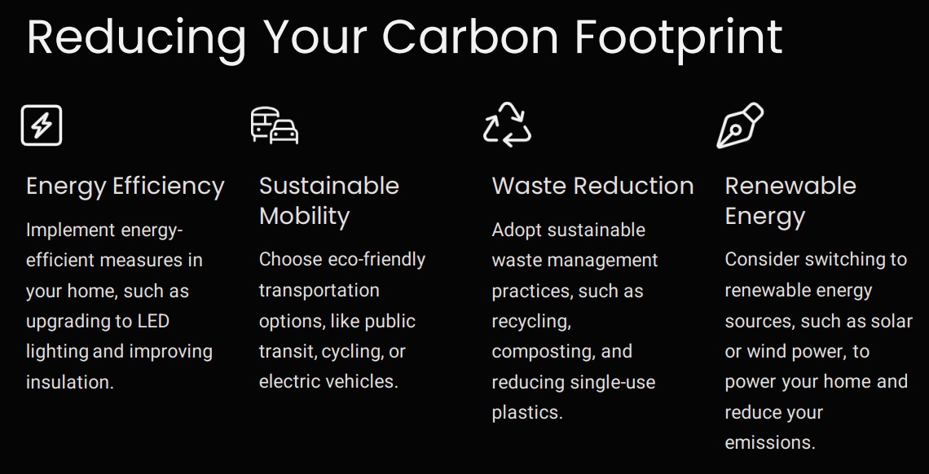

Slide 12
